Slide 1
Simultaneous localization and mapping
Kostiantyn Isaienkov
Data Science Engineer

Slide 2
SLAM definition
Robot navigation in a previously unknown static environment while building and updating a map continuously using on-board sensors.
When is SLAM necessary?
Robot must be autonomous (without any human activity).
No prior knowledge about the map.
No opportunity to place beacons (also in GPS-denied environments).
Robot needs to know its own position.

Slide 3
Robotic sensors classification
By orientation:
Proprioceptive. Measures values internally to the system (battery level, wheel position, joint angle).
Exteroceptive. Observations of robot environment, objects in it.
By state:
Active - emits energy.
Passive - passively receives energy.
Sensor | Orientation | State
Whiskers, bumpers | EC | P
Cameras | EC | P
Ultrasonic sensor, laser rangefinder | EC | A
Gyroscopes | PC | P

Slide 4
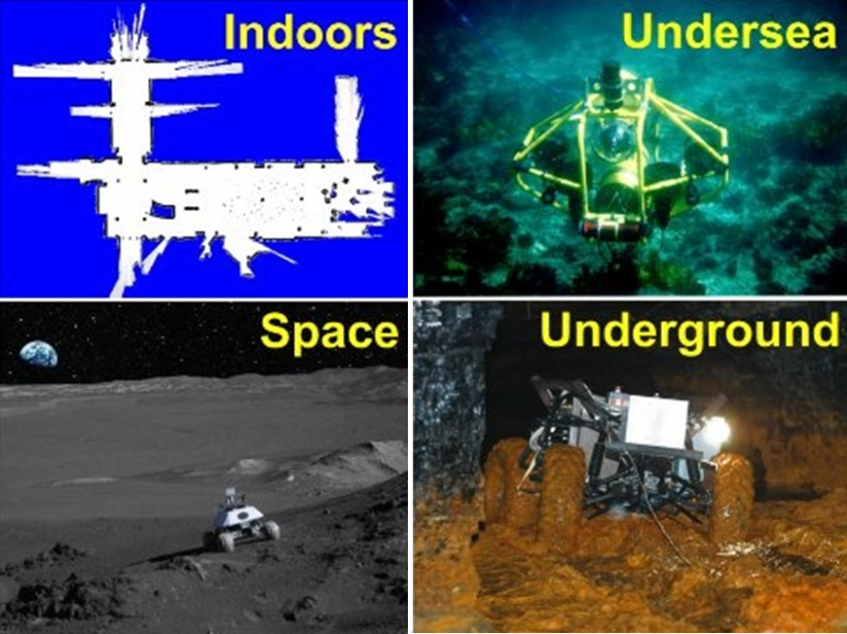
SLAM applications

Slide 5
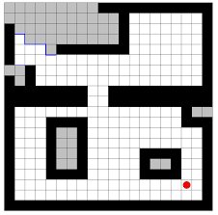
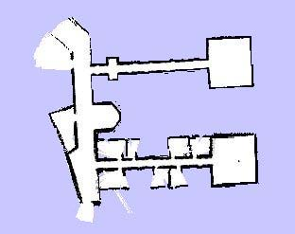
Robot map representation
GRID MAP
FEATURE BASED MAP

Slide 6
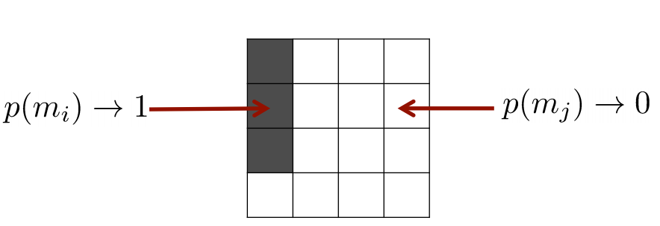

Grid map
Discretize the world into cells.
Grid structure is rigid.
Each cell is assumed to be occupied or free space.
Non-parametric model.
Large maps require memory resources.
No feature detector.
Each cell is a binary random variable that models the occupancy.
Cell is occupied: ${P(m}_{i})$ = 1
Cell is not occupied: ${P(m}_{i})$ = 0
No knowledge: ${P(m}_{i})$ = 0.5

Slide 7
Feature based map
Point landmarks, walls and other types of obstacles.
Feature models can be arbitrarily precise.
A landmark feature has parameters (x ,y), the robot’s pose has parameters (x, y, ϕ).

Slide 8
SLAM features
SLAM algorithms make maps from natural scene features.
Laser/sonar: wall segments, planes, corners, obstacles, etc.
Vision: salient point features, lines, textured surfaces.
Features should be distinctive and easily recognizable from different viewpoints to enable reliable matching.

Slide 9
TASK formulation
INPUTS:
OUTPUTS:
Time sequence of measure-ments made as robot moves through an initially unknown environment.
The robot controls.
Observations of near by features.
Robot position estimation in the coordinate system of the map.
An update the map of the environment.
Path of the robot (optionally).

Slide 10
TASK formulation
State/Output:
Map of the environment, which has been observed so far.
Robot position estimation.
Action/Input:
Move to a new position.
Acquire additional observations.
Update state:
Re-estimate robot position.
Re-estimate the map.
Errors come from inaccurate measurement of actual robot motion (noisy action) and the distance from obstacle/landmark (noisy observation).
Small errors will quickly accumulate over time steps.

Slide 11

TASK formulation
Given:
Input, control signal $U_{1:k}=\{u_{1},u_{2},…,u_{k}\}$;
Observations $Z_{1:k}=\{z_{1},z_{2},…,z_{k}\}$;
Create:
Map of features $M=\left\{m_{1},m_{2},…,m_{k}\right\}$;
Robot path (states) $X$ = {${x_{0},x}_{1},x_{2},…,x_{k}$}.

Slide 12
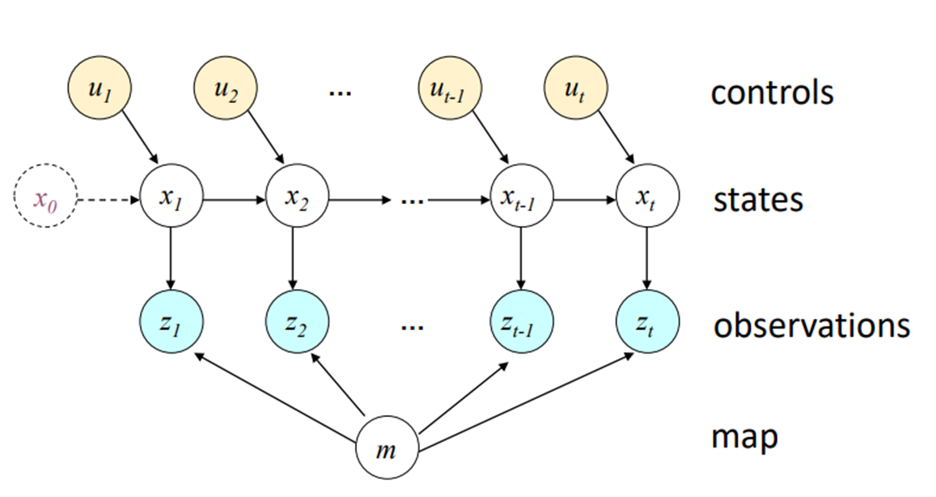
Graphical model of SLAM

Slide 13
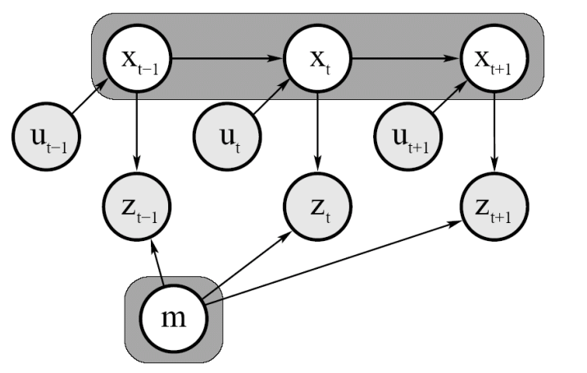
Graphical model of Full SLAM
Full SLAM estimates entire path and map using whole set of observations and controls.

Slide 14
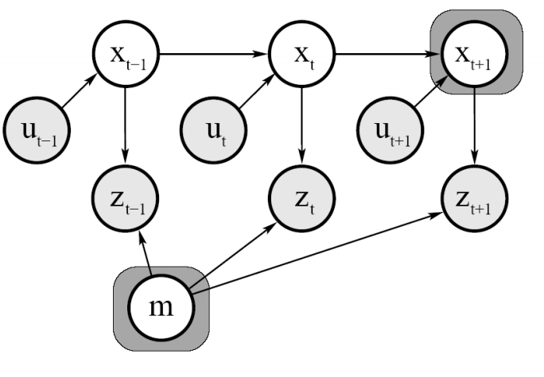
Graphical model of online SLAM
Online SLAM estimates most recent position and map condition by previous observations and controls.

Slide 15
Difficulties
SLAM is a chicken or egg problem.
A map is needed for localizing a robot.
A good robot position estimate is needed to create/update the map.
SLAM is considered one of the most fundamental problems for mobile robots to be truly autonomous.
Variety of methods have been tried to approach SLAM problem.
Probabilistic methods.
Small errors will quickly accumulate over time steps.
Position error correlates data associations.

Slide 16
Why SLAM is so hard?
Uncertainty at every level of the problem.
Many ingredients:
Autonomous, collaborative robots.
Mapping is multi-scale in generic environments.
Map-making:
Difficult also for humans.
Humans make mapping mistakes.
Scaling issues

Slide 17
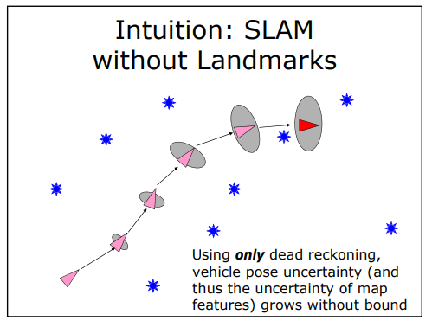
SLAM without landmarks

Slide 18
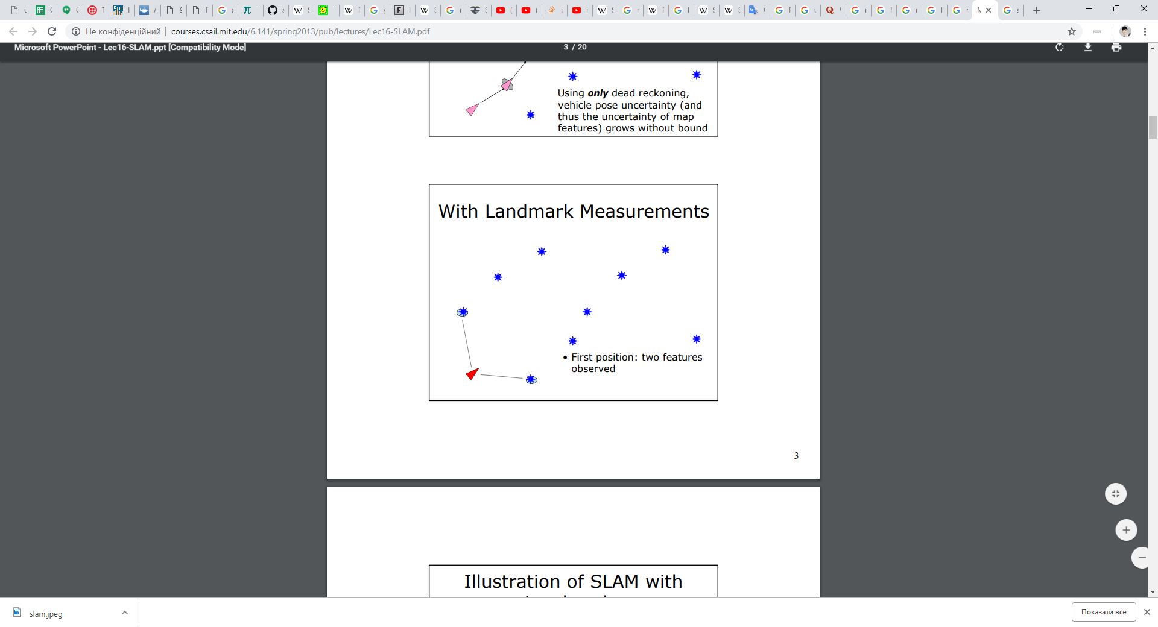
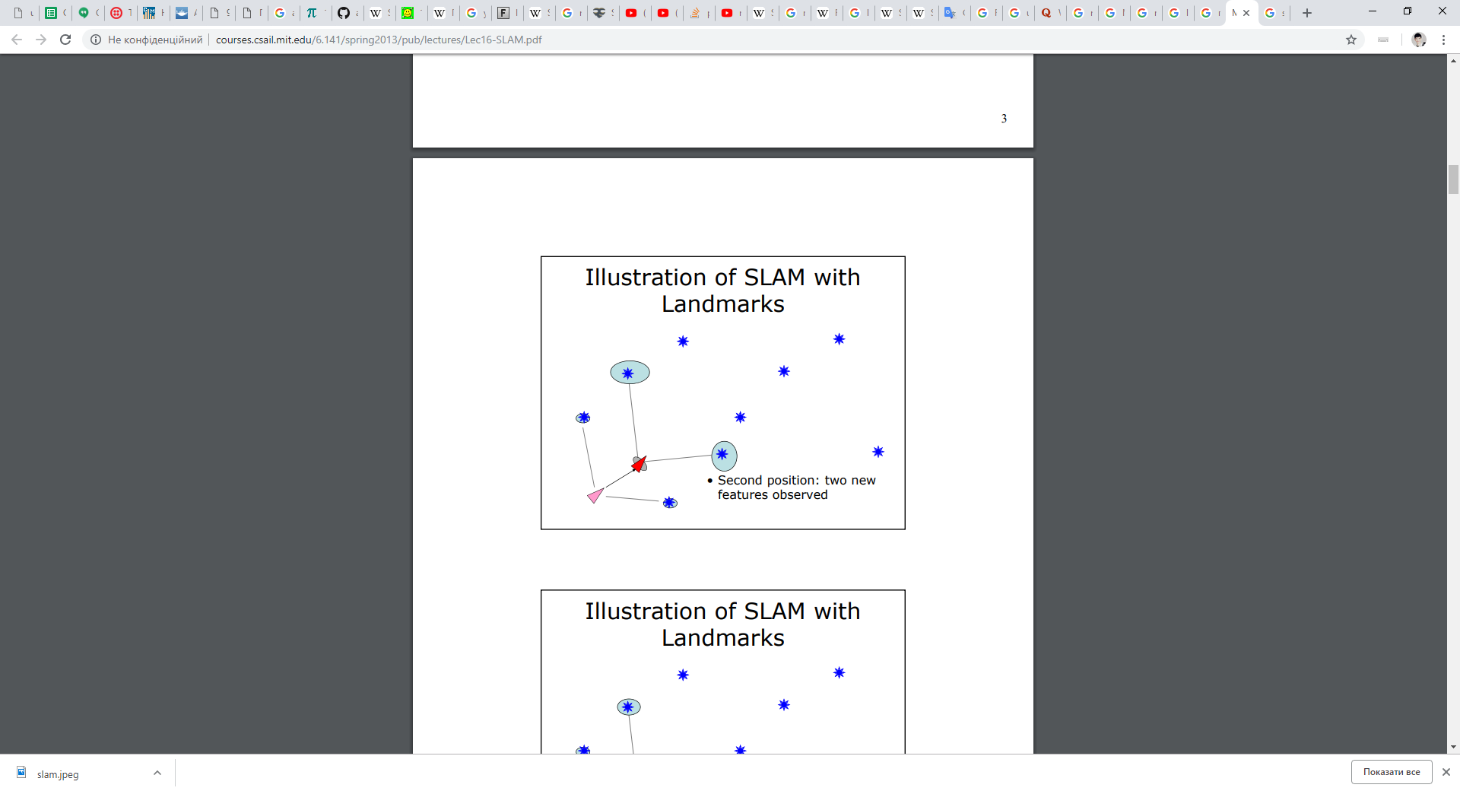
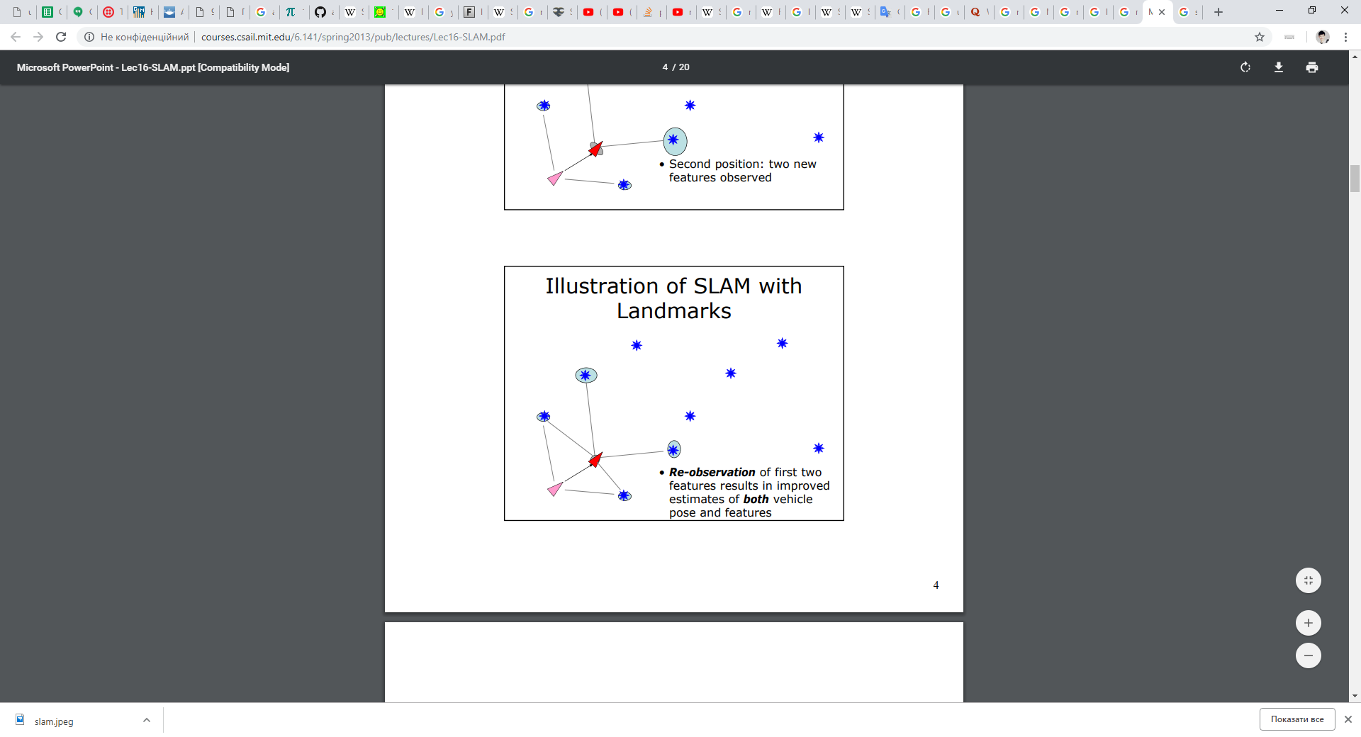
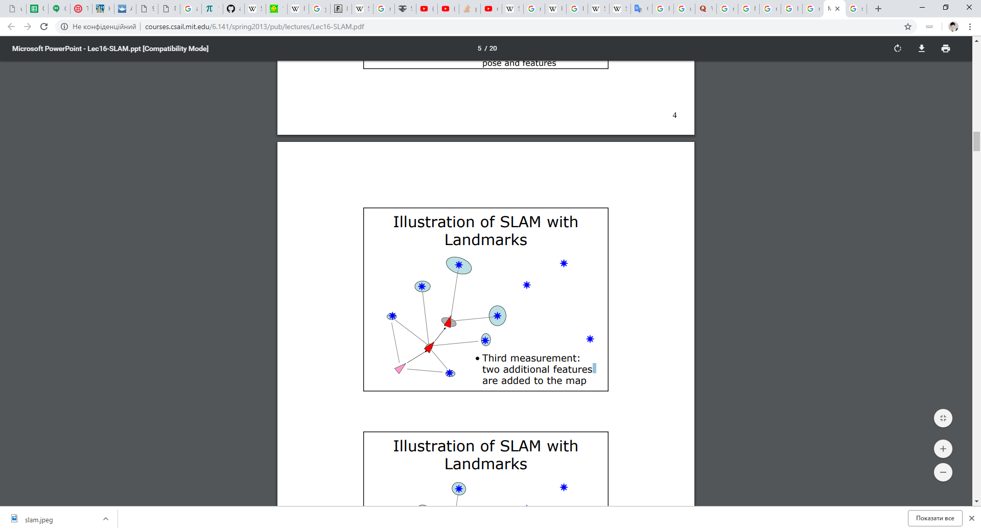
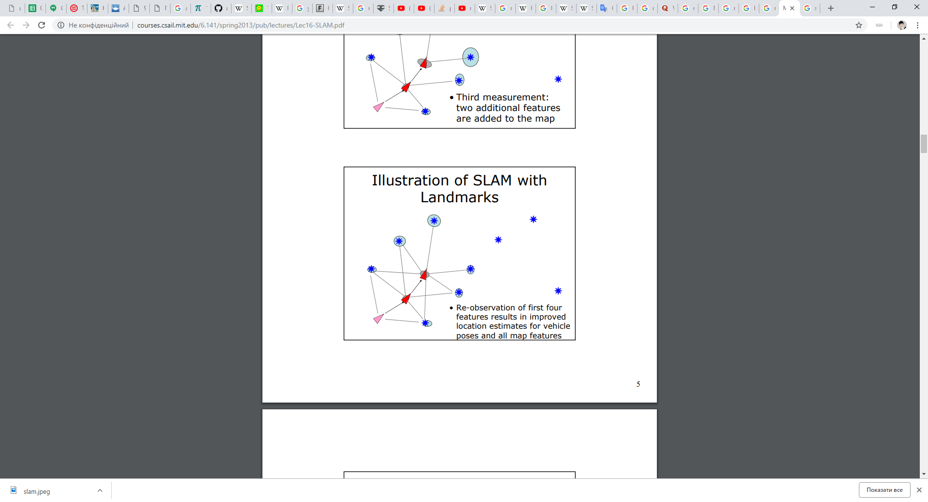
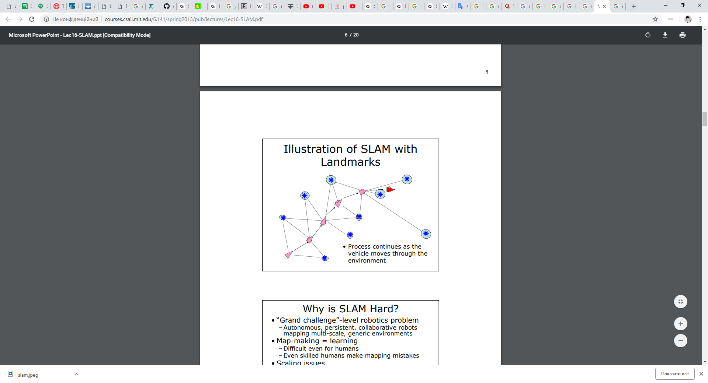
SLAM with landmarks

Slide 19
Scan matching
Given a scan and a map (scan and scan) find the rigid transformation that aligns them the best.
Solution:
Reduce scan-map to a point cloud and run the Iterative closest point algorithm (ICP).
Usage:
Mostly for map correction in multi-agent SLAM with independent agents.

Slide 20
Iterative point cloud algorithm
For each point in the source cloud, find the closest point in the reference cloud.
Estimate the combination of rotation and translation using a root mean square distance metric minimization technique which will best align each source point to its match found in the previous step.
Transform the source cloud using the obtained transformation.
Iterate until threshold was achieved.

Slide 21

Kalman filter
Gives the best estimation for the given model.
Update state and error sequentially.
State representation:
$x_{t}=\{X,Y,\text{θ}$, $m_{1_{x}, }$ $m_{1_{y}, }$ $m_{2_{x}, }$ $m_{2_{y}, }…,m_{n_{x}, } m_{n_{y} }\}$;

Slide 22


Kalman filter algorithm
Model description
$x_{k}$=${Ax}_{k−1}$+ ${Bu}_{k}$
$z_{k}$=${Cx}_{k}$+ $v_{k}$
Prediction
$\hat{{ x}_{k}}$ =$A\hat{x_{k−1}}$+ ${Bu}_{k}$
$P_{k}= {AP}_{k−1}A^{T}$
Correction
$G_{k}= P_{k}C^{T}{(CP_{k}C^{T}+R) }^{−1}$
$\hat{ x_{k}}$ ←$\hat{x_{k}}$+ $G_{k}(z_{k}−C\hat{x_{k}})$
$P_{k}$← $(I−G_{k}C)P_{k}$
$x$ – state;
$z$ - observed state;
$u$ - control;
$\hat{x}$ - predicted state;
$A$ – state transition matrix;
$C$ – signal scaling;
$B$ – control rule;
$P$ – prediction error;
$G$– correction;

Slide 23

Extended Kalman filter
Problem of Kalman filter: linear models usually not applicable in real world.
Solution: use extended Kalman filter, that works with nonlinearity.
Model description
$x_{k}$= $f(x_{k−1}, u_{k})$
$z_{k}$= $h\left(x_{k}\right)+v_{k}$
Prediction
$\hat{x_{k}}$= $f(\hat{x_{k−1}}, u_{k})$
$P_{k}=$ $F_{k−1} P_{k−1}F_{k−1}^{T}$ + $Q_{k−1}$
Correction
$G_{k}= P_{k}H_{k}^{T}{(H_{k}P_{k}H_{k}^{T}+R) }^{−1}$
$\hat{ x_{k}}$ ←$\hat{x_{k}}$+ $G_{k}(z_{k}−h\left(\hat{x_{k}}\right))$
$P_{k}$← $(I−G_{k}H_{k})P_{k}$
f, h – nonlinear functions.
F, H – Jacobians.
Q, R – noise.

Slide 24
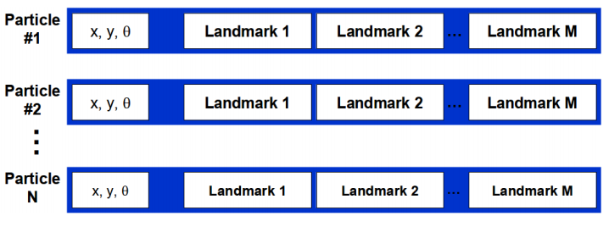
Particle filter
Represent the distribution of robot location by a large amount of simulated samples. Approximation of Parametric method.
Each landmark is represented by a 2x2 Extended Kalman Filter.
Each particle therefore has to maintain M EKFs.
Resample state and map at each time step.

Slide 25
Fast SLAM based on Particle filter
Sample a new robot path given the new control.
Update landmark filters corresponding to the new observation.
Assign a weight to each of the particles.
Resample the particles according to their weights.
Algorithm

Slide 26
Visual SLAM
Systems work by tracking set points through successive camera frames.
Possibility to work with a single 3D camera.
As long as there are a sufficient number of points being tracked through each frame, both the orientation of the sensor and the structure of the surrounding physical environment can be rapidly understood.
Systems are working to minimize the difference between the projected and actual points, usually through an algorithmic solution called bundle adjustment.
Visual SLAM systems operate in real-time.

Slide 27
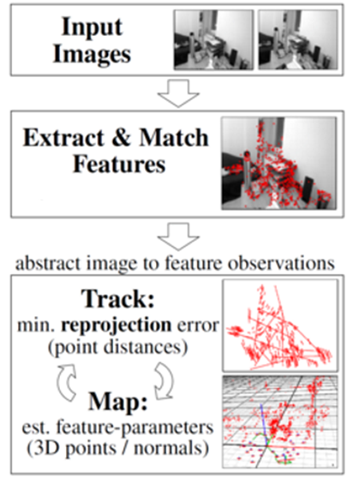
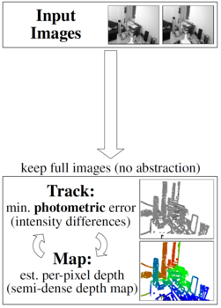
VSLAM summary
3D instead of 2D : Images instead of laser scans
2 Types of VSLAM: Feature-Based (indirect) and Direct

Slide 28
VSLAM summary
Feature-based
Find keypoints in image
Match to keypoints in other images
Pose estimation from matched features between images
Finding matches between current frame and a set of previous frames
Direct
Recover the environment depth and structure and the camera pose through an optimization on the map and camera parameters together.
Faster than indirect method because no feature processing.
Sensitive to light changes.

Slide 29
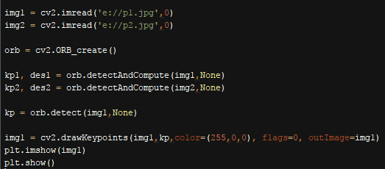
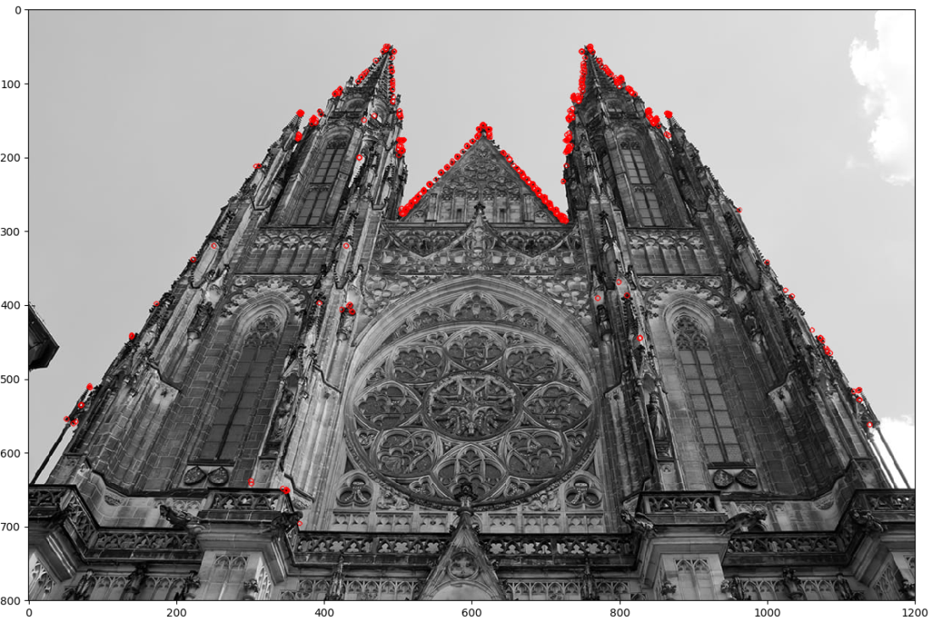
Keypoints detection

Slide 30
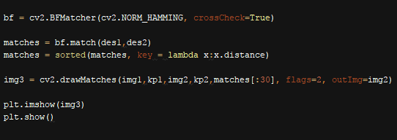
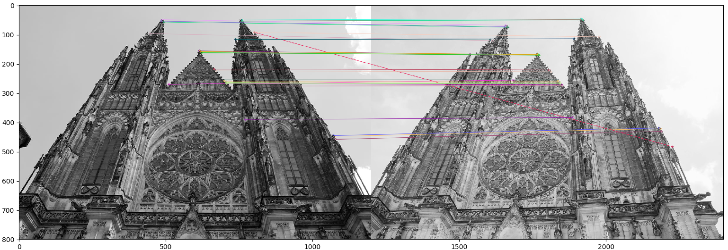
Keypoints matching

Slide 31




Camera parameters
Intrinsic parameters
K = $\left[\begin{matrix}f_{x} & γ & u \\ 0 & f_{y} & v \\ 0 & 0 & 1\end{matrix}\right]$
$f_{x}, f_{y}$– focal length in term of pixels;
$γ$ - skew coefficient between the x and the y axis;
$u$, $v$ - principal point, which would be ideally in the center of the image.
Extrinsic parameters
E = $\left[\begin{matrix}R & T \\ 0_{3}^{T} & 1\end{matrix}\right]$
R – rotation (3x3) matrix,
T – (3x1) position of the origin of the world coordinate system expressed in coordinates of the camera-centered coordinate system.
Denote the coordinate system transformations from 3D world coordinates to camera coordinates
The position of the camera in real world: $C=−R^{T}T.$

Slide 32

Camera auto-calibration
$x=\left[K | 0\right]×(E×X)$
$x={[x,y,1]}^{T}$
$X= {[X,Y,Z,1]}^{T}$
Algorithm
Search for keypoints on all images.
Find matches between keypoints.
Filter out false matches.
Solve system of equations.

Slide 33
Technology stack for SLAM simulator
JetBrains PyCharm Community Edition 2017.2.3 x64
Python 3.6.5
numpy 1.16.0
scipy 1.2.0
pygame 1.9.4

Slide 34

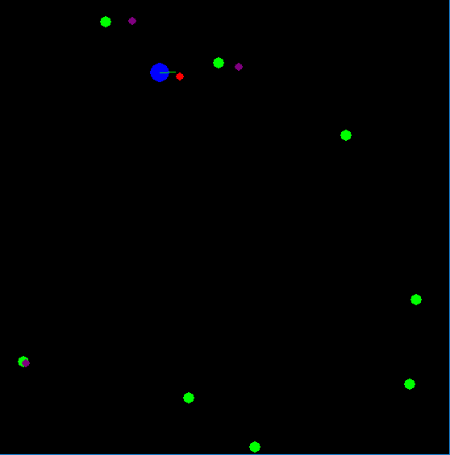
Pygame
Pygame is a cross-platform set of Python modules designed for writing video games.
Used for creation of user interface and processing keyboard inputs.

Slide 35
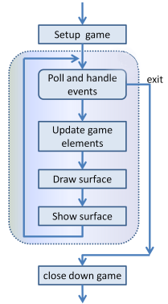
Game loop
Setup section - create a window, load and prepare some content, and then enter the game loop.
Game loop:
Poll for events — catch events that have occurred.
Update internal data structures or objects need changing.
Draw the current state of the game into surface.
Put the just-drawn surface on display.

